Slide 1


Capstone Project
Retail
Notes:
Hi everyone,
My name is Shiraj Ahmad,
and I'm a mentor here for data science.
In this session, I'll be explaining Power BI's Capstone Project: Retail
First, congratulations on completing Excel, SQL, and Power BI.
After completing this Capstone Project, you'll be job-ready!
So, let's get started.

Slide 2
Overview
Sales Analysis
Product Analysis
Customer Analysis
Demographic Analysis
This Dataset contains data regarding Retail store.
Notes:
Overview of Power BI Dashboard for Retail Database:
The Power BI Dashboard for the Retail Database is a comprehensive and insightful tool designed to analyze various aspects of the retail business. It focuses on four key areas: Sales Analysis, Product Analysis, Customer Analysis, and Demographic Analysis. By leveraging data from the retail database, the dashboard offers valuable visualizations and analytics to support data-driven decision-making and strategic planning.
Sales Analysis: The Sales Analysis section of the dashboard provides a detailed overview of the retail business's sales performance. It includes key metrics such as total revenue, sales trends over time, and sales by product categories. Users can drill down into sales data to identify top-selling products, best-performing regions, and peak sales periods. This analysis helps retailers optimize inventory, plan promotions, and forecast revenue.
Product Analysis: The Product Analysis section focuses on understanding product performance and trends. It showcases product sales, inventory levels, and customer feedback for each product category. Users can explore product-specific data, such as best-selling items, slow-moving products, and product profitability. This analysis enables retailers to make data-driven decisions about product assortment, pricing, and marketing strategies.
Customer Analysis: The Customer Analysis section provides insights into customer behavior and preferences. It includes metrics like customer demographics, purchase frequency, and customer loyalty. By segmenting customers based on buying patterns, retailers can tailor marketing campaigns and enhance customer retention strategies. Additionally, customer feedback data helps identify areas for improvement and enhances the overall customer experience.
Demographic Analysis: The Demographic Analysis section focuses on understanding the customer base's demographics. It presents visualizations of customer age groups, gender distribution, and geographic locations. Retailers can use this information to identify target demographics, customize marketing messages, and expand into new markets based on customer profiles.
Comprehensive Retail Insights: The Power BI Dashboard offers a holistic view of the retail business, providing valuable insights into sales, product performance, customer behavior, and demographics.
Actionable Analytics: By presenting data through interactive visualizations, the dashboard enables users to derive actionable insights and make informed decisions that positively impact business outcomes.
Enhanced Customer Engagement: Understanding customer preferences through demographic and customer behavior analysis helps retailers personalize interactions and create more engaging shopping experiences.
Improved Inventory Management: Sales and product analysis empower retailers to optimize inventory levels, ensuring the availability of popular products while minimizing excess stock.
Data-Driven Marketing Strategies: With customer and sales data at their disposal, retailers can implement targeted marketing campaigns that resonate with their customer base, leading to increased customer acquisition and retention.
In conclusion, the Power BI Dashboard for the Retail Database offers a comprehensive solution for analyzing sales, product performance, customer behavior, and demographics. By leveraging these valuable insights, retailers can enhance decision-making, improve customer experiences, optimize inventory, and drive business growth in the competitive retail landscape.

Slide 3

Problem Statement
Objective
Analysis Scope
Goal
Insights & Recommendations.
Report & Presentation
Notes:
Problem Statement for Power BI Dashboard using Retail Database:
Objective:
The objective of this project is to develop a Power BI dashboard using the Retail Database that provides comprehensive insights into the retail business's performance. The dashboard aims to facilitate data-driven decision-making, optimize sales strategies, and enhance customer experiences.
Analysis Scope:
The analysis will focus on four key areas: Sales Analysis, Product Analysis, Customer Analysis, and Demographic Analysis. It will cover sales trends, product performance, customer behavior, and customer demographics to offer a comprehensive understanding of the retail business.
Goal:
The primary goal of the Power BI dashboard is to empower retail stakeholders with actionable insights. The dashboard will help identify top-selling products, peak sales periods, customer preferences, and target demographics. It will enable retailers to make informed decisions to boost sales, optimize inventory, and tailor marketing strategies.
Insights & Recommendations:
The Power BI dashboard will provide valuable insights into sales performance, product trends, customer behavior, and demographic patterns. It will identify high-performing products, low-performing items, customer preferences, and opportunities for customer engagement and retention. Based on the analysis, the dashboard will recommend targeted marketing strategies, inventory optimization, and personalized customer experiences.
Report & Presentation:
The final deliverables will include a comprehensive report detailing the data sources, data modeling, and data cleaning processes used to create the Power BI dashboard. The report will describe the key insights derived from the dashboard's analysis and outline the actionable recommendations for business improvement. The presentation will showcase the dashboard's visualizations, the significance of the findings, and how stakeholders can utilize the dashboard for effective decision-making.
The Power BI dashboard, along with the report and presentation, will serve as a powerful tool for retail stakeholders, providing a deeper understanding of sales, products, customers, and demographics. It will enable retailers to optimize their business strategies, enhance customer satisfaction, and achieve business growth and success in the competitive retail market.

Slide 4


Significance
Valuable insights
Improvement focus
Evaluation of effectiveness
Trend identification
Comprehensive understanding
Notes:
Significance of Power BI Dashboard using Retail Database:
Valuable Insights:
The Power BI Dashboard offers valuable insights into the retail business's performance, including sales trends, product performance, customer behavior, and demographic patterns. These insights enable stakeholders to make data-driven decisions, identify lucrative opportunities, and address potential challenges effectively.
Improvement Focus:
By analyzing sales data, customer behavior, and product performance, the dashboard helps retail businesses focus on areas that require improvement. Retailers can identify low-performing products, optimize inventory management, and implement targeted marketing strategies to enhance overall business performance.
Evaluation of Effectiveness:
The dashboard facilitates the evaluation of various business strategies and initiatives. Retailers can measure the effectiveness of marketing campaigns, assess customer retention efforts, and evaluate product promotions. This evaluation guides retailers in refining their approaches and reallocating resources for better outcomes.
Trend Identification:
Through trend analysis, the dashboard identifies patterns in sales, customer preferences, and demographic trends. It helps retailers understand seasonal sales fluctuations, popular product categories, and customer buying behaviors over time. Identifying trends enables proactive planning and adapting strategies to changing market dynamics.
Comprehensive Understanding:
The Power BI Dashboard provides a comprehensive understanding of the retail business by consolidating data from various aspects, such as sales, products, customers, and demographics. This holistic view enables stakeholders to grasp the overall performance and dynamics of the retail business.
Benefits:
1. Data-Driven Decision Making:
The Power BI Dashboard empowers retail stakeholders to make informed decisions based on data-driven insights. It reduces reliance on intuition and ensures more accurate and effective decision-making processes.
2. Business Optimization:
By focusing on areas that need improvement and identifying growth opportunities, the dashboard enables retailers to optimize their business strategies, leading to increased efficiency and profitability.
3. Proactive Strategy:
With trend identification and evaluation of effectiveness, the dashboard helps retailers take a proactive approach to adapt to market changes and implement successful business strategies ahead of competitors.
4. Enhanced Customer Experience:
Understanding customer behavior and demographics allows retailers to tailor marketing efforts and improve customer satisfaction. Personalized experiences foster stronger customer relationships and loyalty.
5. Comprehensive Business Performance View:
The dashboard's comprehensive view of sales, products, customers, and demographics offers a holistic understanding of the retail business, allowing stakeholders to address challenges from a broader perspective.
In conclusion, the Power BI Dashboard using the Retail Database offers valuable insights, guides improvement efforts, evaluates strategy effectiveness, identifies trends, and provides a comprehensive understanding of the retail business. By leveraging these insights, retail businesses can make informed decisions, optimize operations, and deliver exceptional customer experiences to achieve sustained growth and success in the competitive retail industry.

Slide 5
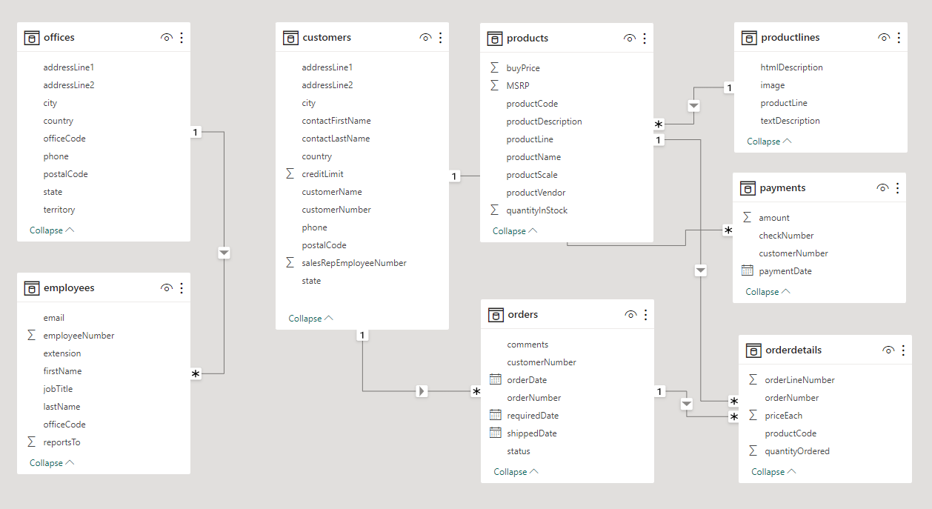
ER Diagram
Notes:
Now that we have comprehended the problem statement and recognized the significance of the project, let's delve into a thorough understanding of the dataset.
The Entity-Relationship (ER) diagram for the Power BI Dashboard using the above database represents the relationships and interactions between various entities (tables) in the database. Here's an explanation of the ER diagram based on the provided tables:
Entities:
1. Offices: Represents different retail offices or stores of the business. Each office is identified by a unique office ID and may contain attributes like office name, location, and contact information.
2. Customers: Stores information about individual customers who make purchases from the retail business. Each customer is identified by a unique customer ID and contains attributes like customer name, contact details, and demographic information.
3. Products: Contains details about the products offered by the retail business. Each product is identified by a unique product ID and includes attributes such as product name, description, and price.
4. ProductLines: Represents different product categories or product lines offered by the retail business. Each product line is identified by a unique product line ID and may contain attributes like product line name and description.
5. Payments: Stores information about payments made by customers for their purchases. Each payment is identified by a unique payment ID and includes attributes like payment amount, payment date, and payment method.
6. Orders: Represents individual orders placed by customers. Each order is identified by a unique order ID and contains attributes like order date, customer ID (foreign key), and office ID (foreign key) from where the order was placed.
7. OrderDetails: This table establishes a many-to-many relationship between orders and products. It serves as a junction table, linking orders to the products they contain. It contains foreign keys for order ID and product ID.
8. Employees: Stores data about employees working in the retail business. Each employee is identified by a unique employee ID and contains attributes like employee name, job title, and contact details.
The ER diagram visually presents the structure and relationships of the database, facilitating better understanding and design of the Power BI Dashboard. It provides a clear representation of data entities and their connections, enabling effective data analysis and visualization within the Power BI Dashboard.
I trust that you now have a clear understanding of the Capstone project requirements.

